Slide 1
E-SACCO FLEET MANAGER
STUDENT NAME: JOELLA MVUMBI LUNDENGO
STUDENT NUMBER: X13115898
COURSE NAME: BSC (HONOURS) IN TECHNOLOGY MANAGEMENT
COURSE SPECIALIZATION: BUSINESS ANALYST

Slide 2
DEFINITIONS OF TERMS
Matatu: Privately owned public service vehicle mini-buses in the Kenya ferrying people to different parts of the country.
E-Sacco: A name given to the proposed fleet management application for this project.
Matatu Sacco: Registered companies managing the matatus and buses in the public transportation industry in Kenya.
Fleet Management: The management of commercial vehicles, in this case management of matatus including planning trips, allocating drivers, collecting reports etc.

Slide 3
PROJECT OVERVIEW
Mobile app fleet manager solution.
The application digitizes the management of Matatu Saccos and fleet.
The application is for management of both the Sacco and the fleet.
It address:
Manual Management of vehicles.
Allocation and management trips.
Managing drivers and other support staff.
Automates reports generation.

Slide 4
PROJECT OVERVIEW CONT….
Improves record management.
Bridges the gap between the transport industry and the government.
Tracking the income generation of vehicles.
Difference:
It deals with both Sacco management and fleet management.
Bridging the gap between the government and the industry.
It factors in small businesses as opposed to other Fleet Management Apps.

Slide 5
TECHNIQUES AND TECHNOLOGIES USED
Approach: Agile
Stakeholders: Matatu Saccos, Matatu Owners, System Developer, Business Analyst, Matatu Drivers and Touts, Potential Passengers
Requirements Gathering: Surveys, Interviews, Brainstorming, Prototyping, Requirements Workshop
Techniques: Interface Analysis, MoSCoW Analysis
Technologies: Google Analytics, Blasmiq Software, GitHub, Moscow,

Slide 6
WALKTHROUGH
Project Identification and Information Gathering (Inception)
Identification of Stakeholders
Requirements Gathering
Analysis
Requirements Specification
Most Difficult part: Information gathering and requirements gathering

Slide 7
VALIDATION AND VERIFICATION
Stakeholders Reviews
Prototyping
Interface Analysis workshop

Slide 8
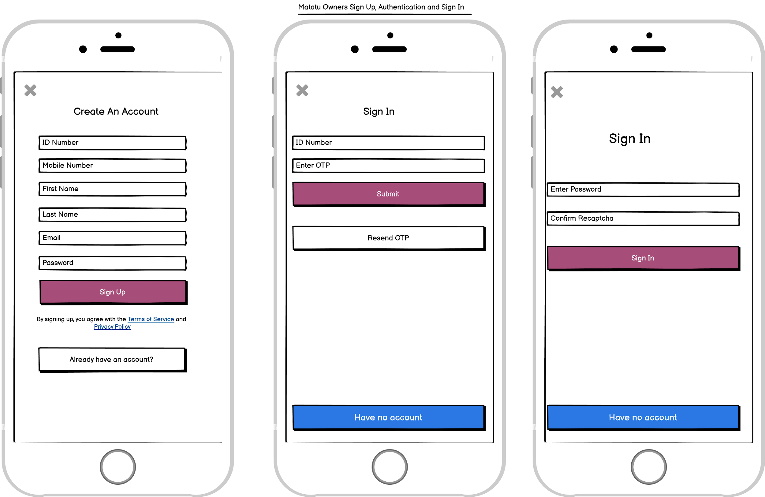
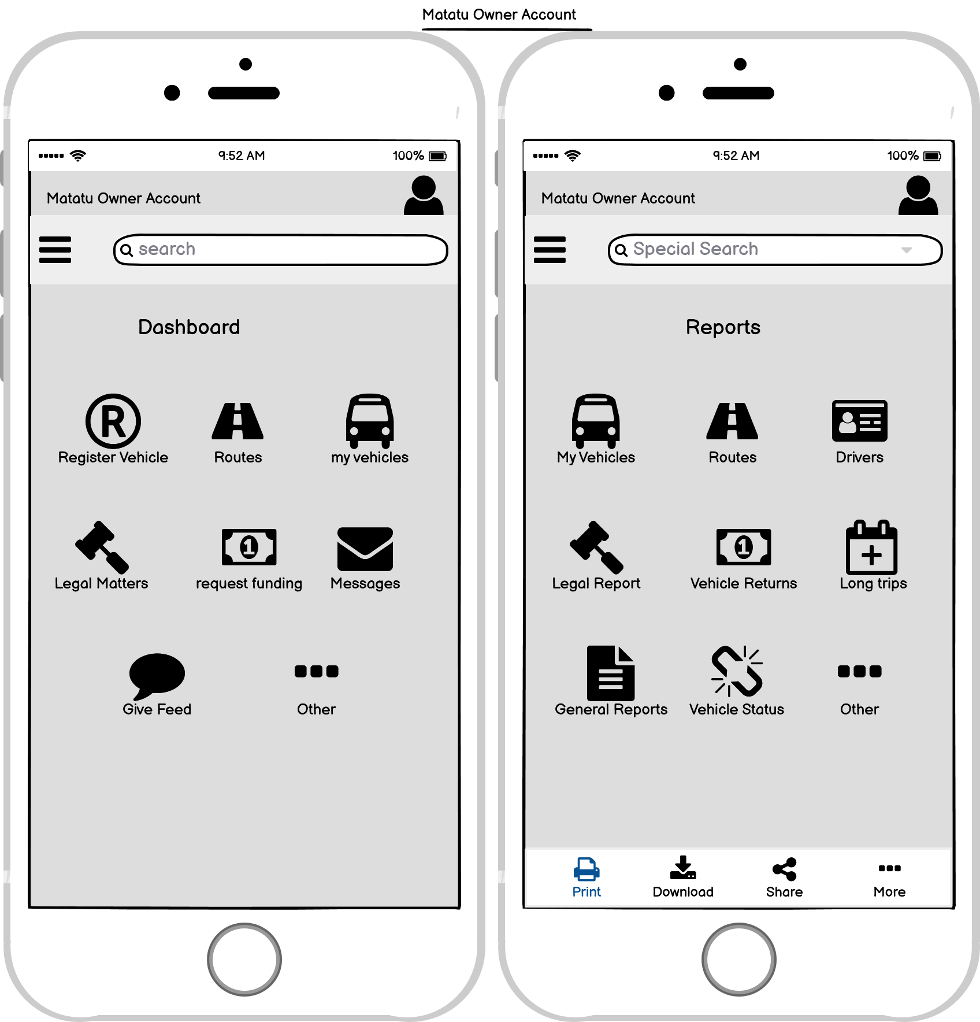
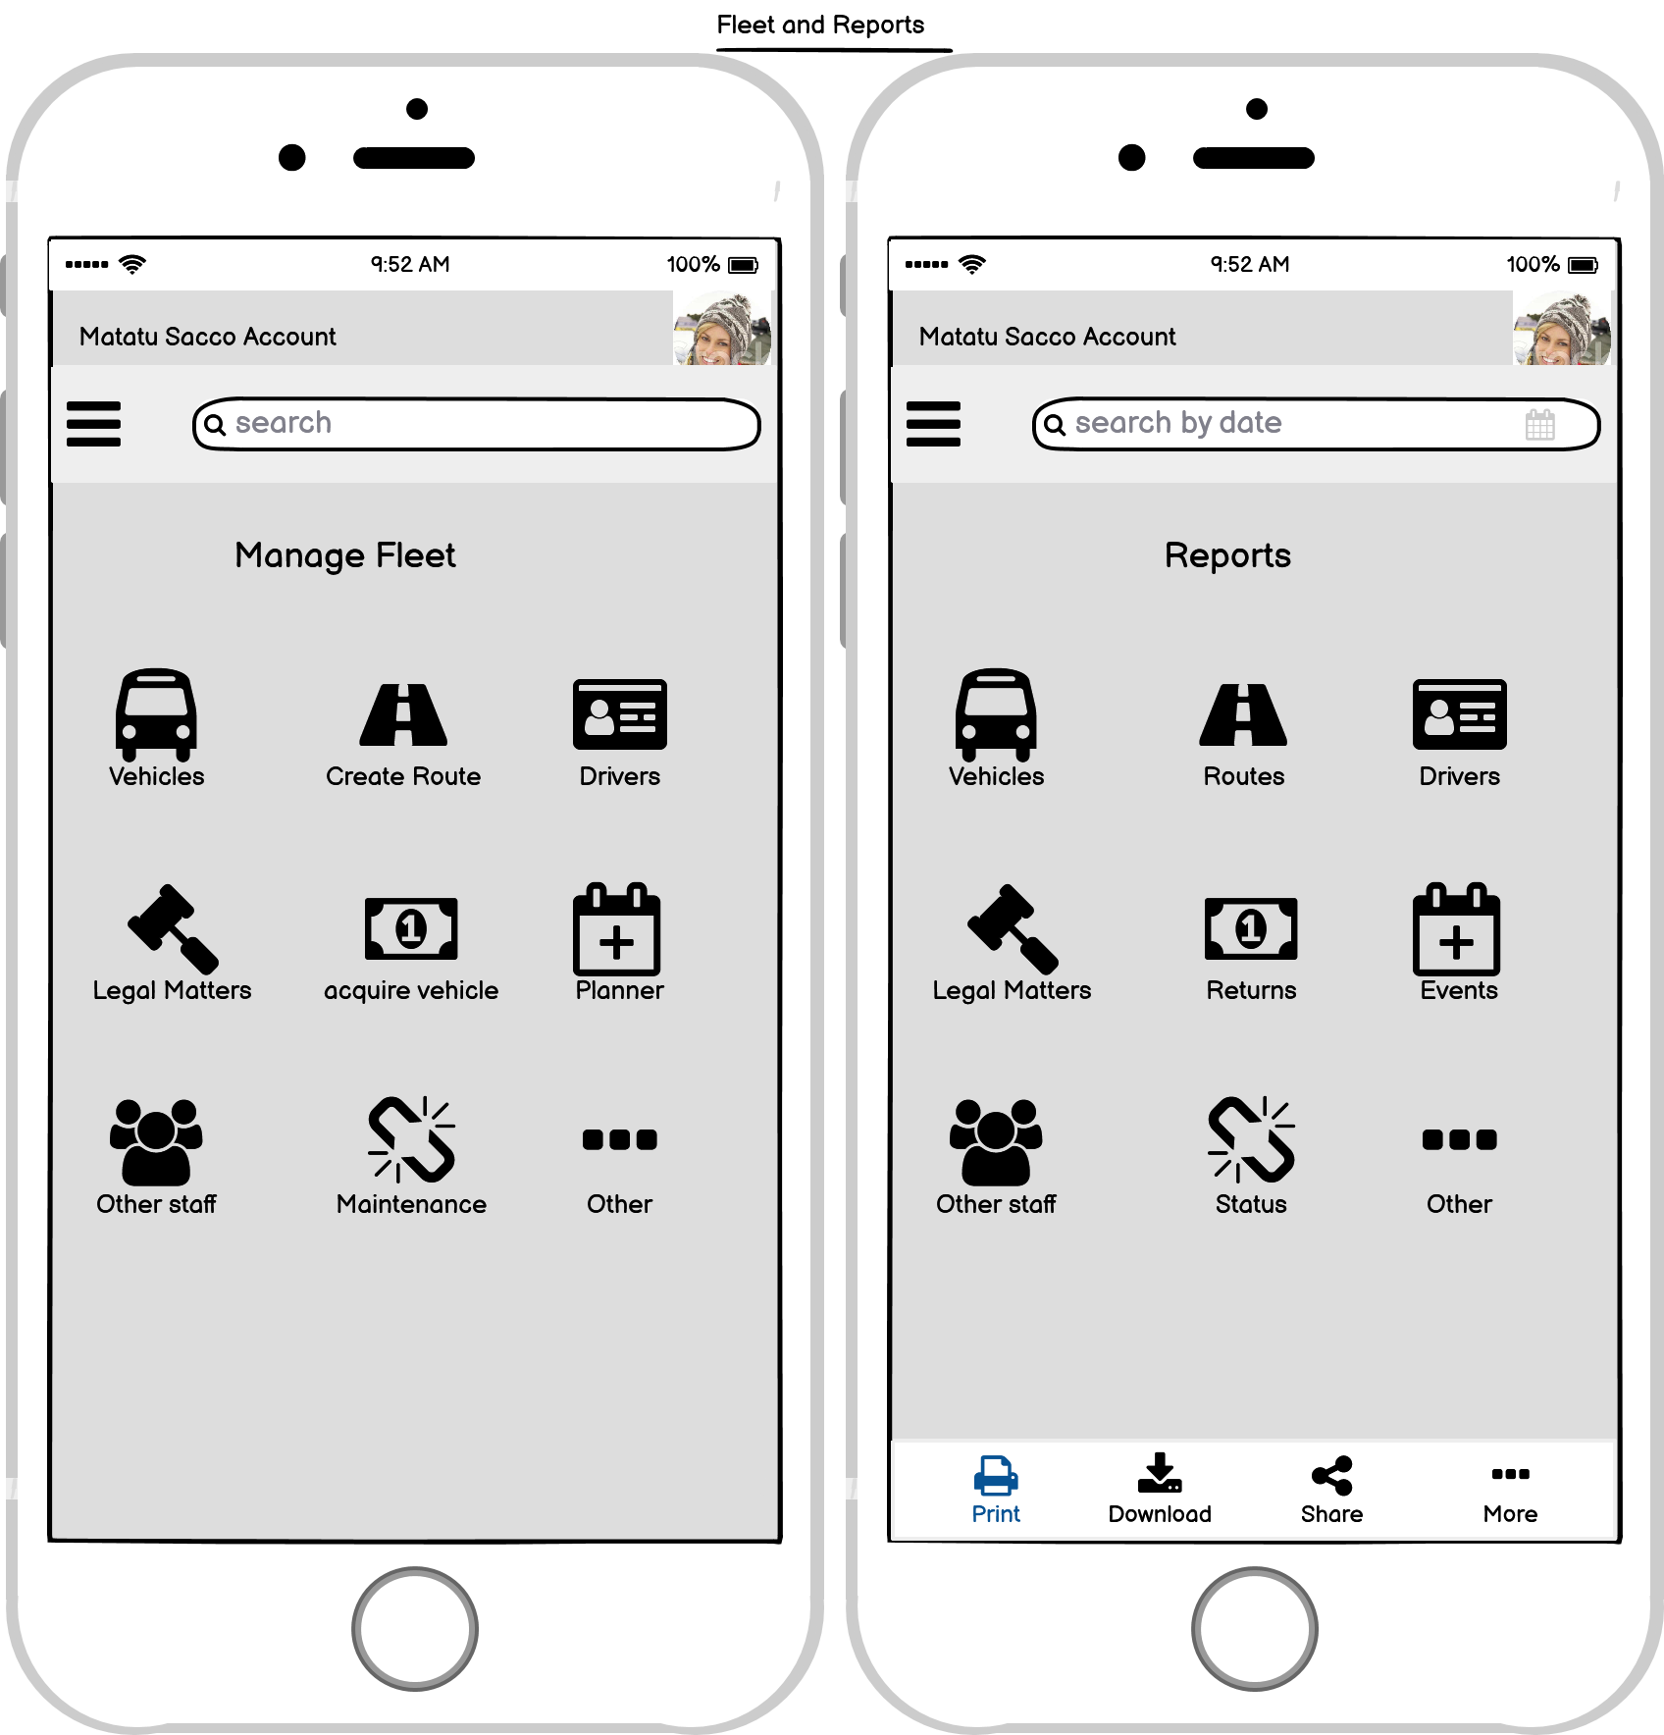
RESULTS

Slide 9
QUESTIONS AND ANSWERS
Discuss the most difficult aspect of your project with particular emphasis on your chosen business analysis techniques
Discuss the most innovative aspect of your project. For example, with respect to the context in which you carried out your requirements gathering activities
With respect to your Aims and Objectives as set out in your project proposal, how have these since changed, and what impact has this had on the completeness of your project?
Describe in detail, your approach to validation & verification
If you were to start your project again would you change any of the decisions you made? For example, in relation to requirements gathering, business analysis, technology etc.

Slide 10
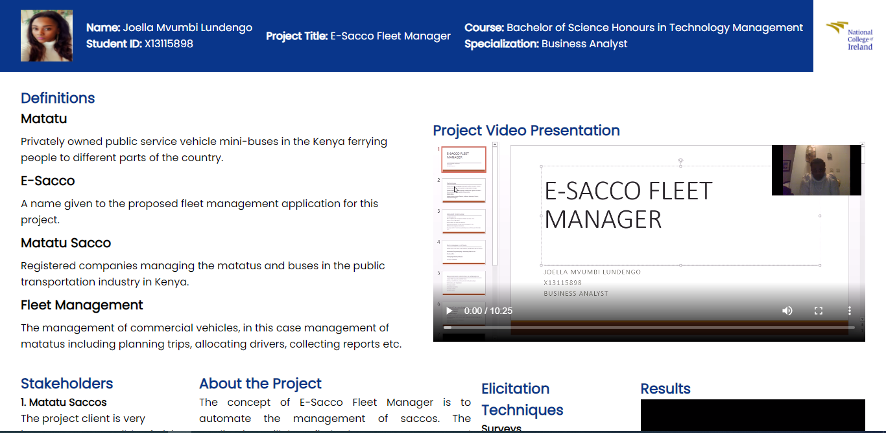
DEMO: WEBSITE

Slide 11
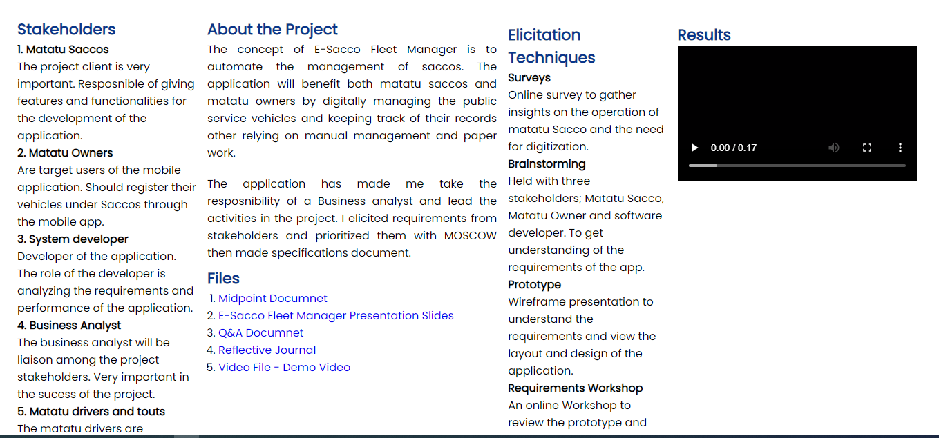
DEMO: WEBSITE

Slide 12
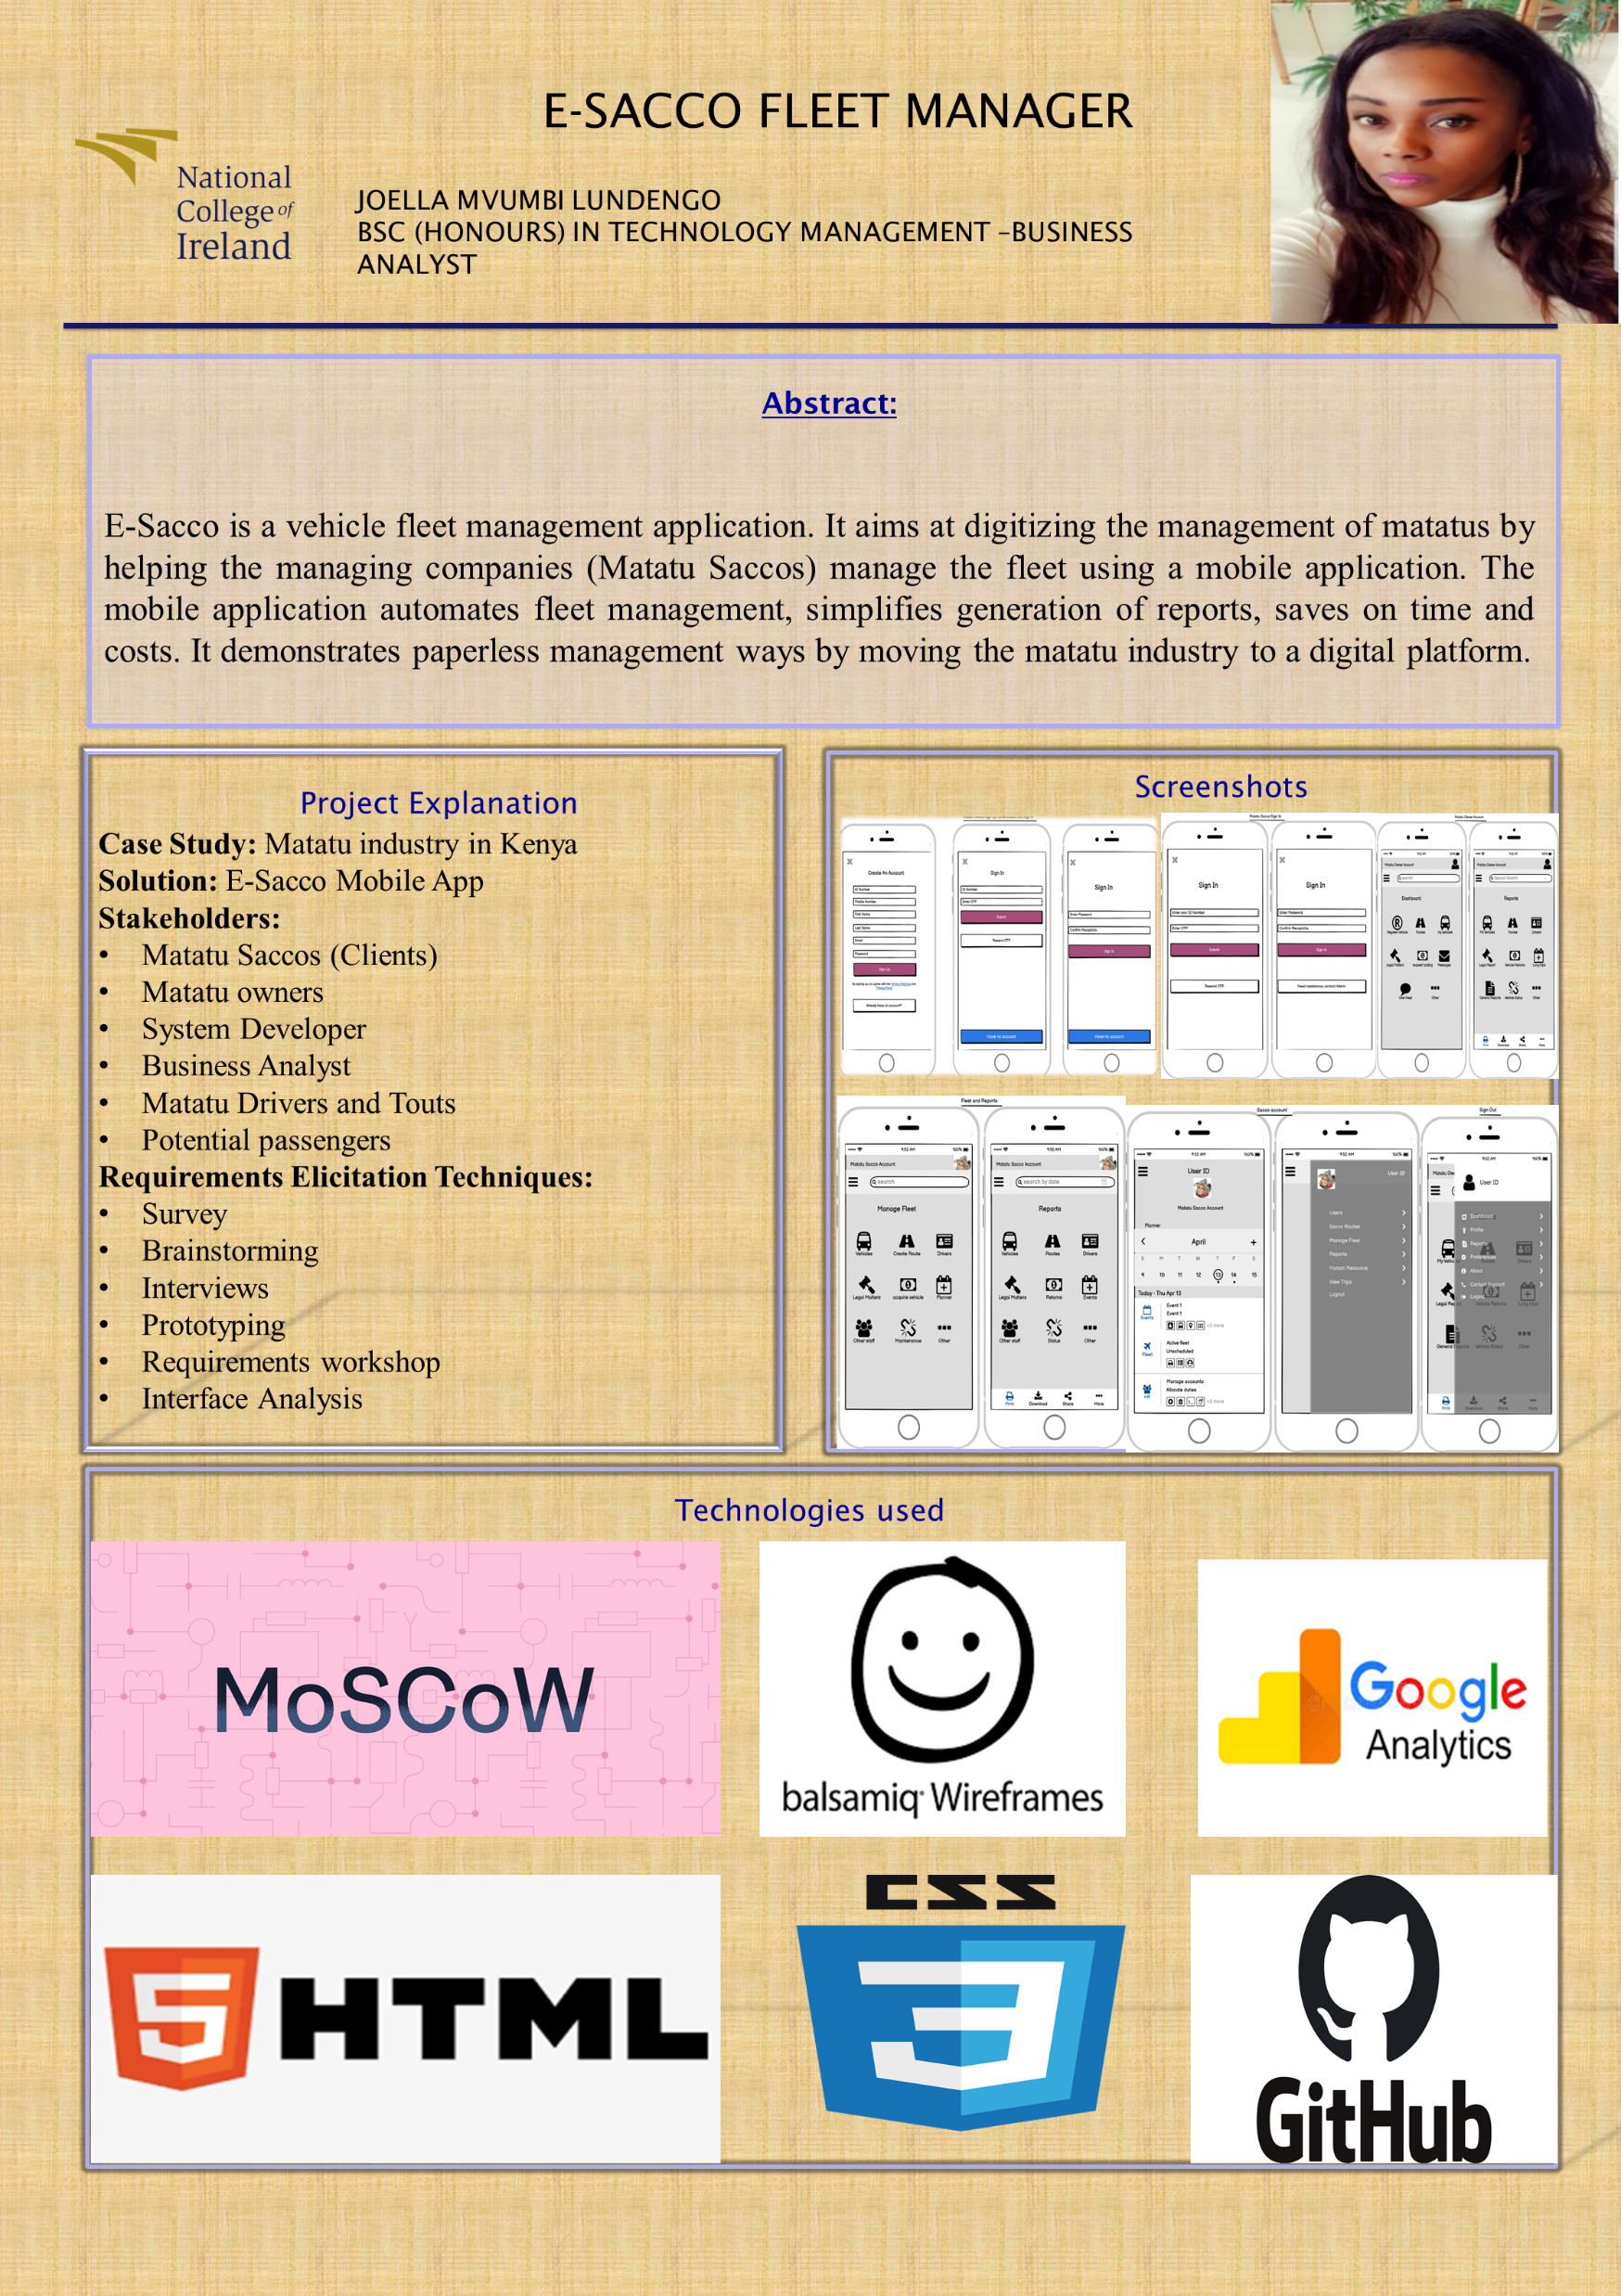
DEMO: SHOWCASE POSTER

Slide 13
THANK YOU.

